Slide 1




Using SLOs for Continuous Performance Optimizations of your k8s workloads
“Proudly powered by our CNCF project ”
Andreas Grabner
DevOps Activist at Dynatrace
DevRel for Keptn
@grabnerandi, https://www.linkedin.com/in/grabnerandi
Follow us @keptnProject
Star us @ https://github.com/keptn/keptn
Slack Us @ https://slack.keptn.sh
Notes:
Moving to k8s doesn’t prevent anyone from bad architectural decisions leading to performance degradations, scalability issues or violating your SLOs in production. In fact – building smaller services running in pods connected through service meshes are even more vulnerable to bad architectural or implementation choices. To avoid any bad deployments, the CNCF project Keptn provides automated SLO-based Performance Analysis as part of your CD process. Keptn automatically detects architectural and deployment changes that have a negative impact to performance and scalability. It uses SLOs (Service Level Objectives) to ensure your services always meet your objectives. The Keptn team has also put out SLO best practices to identify well known performance patterns that have been identified over the years analyzing hundreds of distributed software architectures deployed on k8s. Join this session and learn what these patterns are and how Keptn helps you prevent them from entering production.

Slide 2
Rought Outline and timing (hidden)
Recording: 25-30 minutes to allow live Q&A or 35 minutes
Moving to k8s doesn’t prevent anyone from bad architectural decisions leading to performance degradations, scalability issues or violating your SLOs in production. In fact – building smaller services running in pods connected through service meshes are even more vulnerable to bad architectural or implementation choices. To avoid any bad deployments, the CNCF project Keptn provides automated SLO-based Performance Analysis as part of your CD process. Keptn automatically detects architectural and deployment changes that have a negative impact to performance and scalability. It uses SLOs (Service Level Objectives) to ensure your services always meet your objectives. The Keptn team has also put out SLO best practices to identify well known performance patterns that have been identified over the years analyzing hundreds of distributed software architectures deployed on k8s. Join this session and learn what these patterns are and how Keptn helps you prevent them from entering production.

Slide 3
Performance Patterns

Slide 4
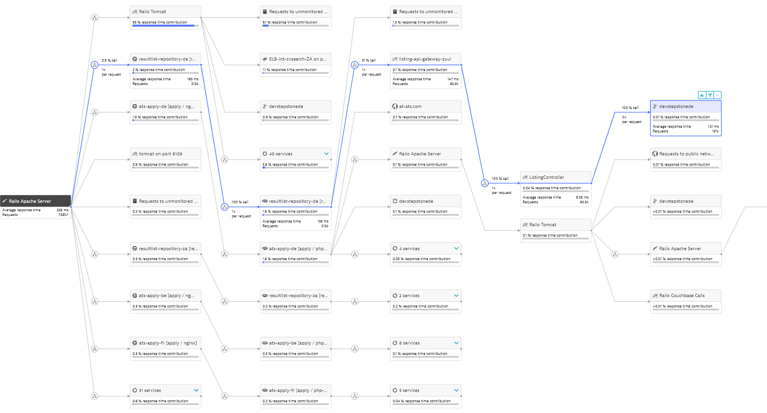
Distributed Traces are a source of great insights
Legacy
Micro-services
Frontend LB
Databases
3rd-party
AWS-ELB

Slide 5
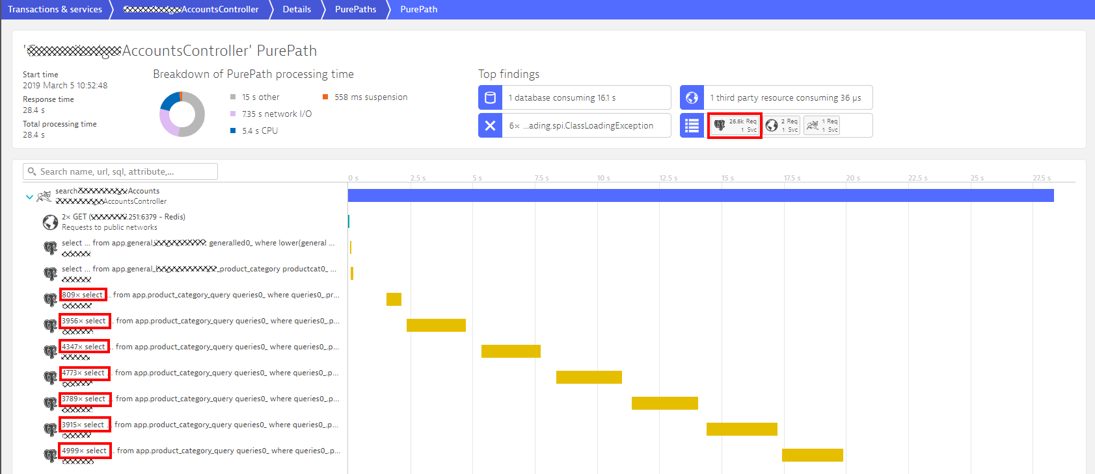
Most common issue I‘ve seen: N+1 Query Issue
26k Database Calls
809
3956
4347
4773
3789
3915
4999

Slide 6
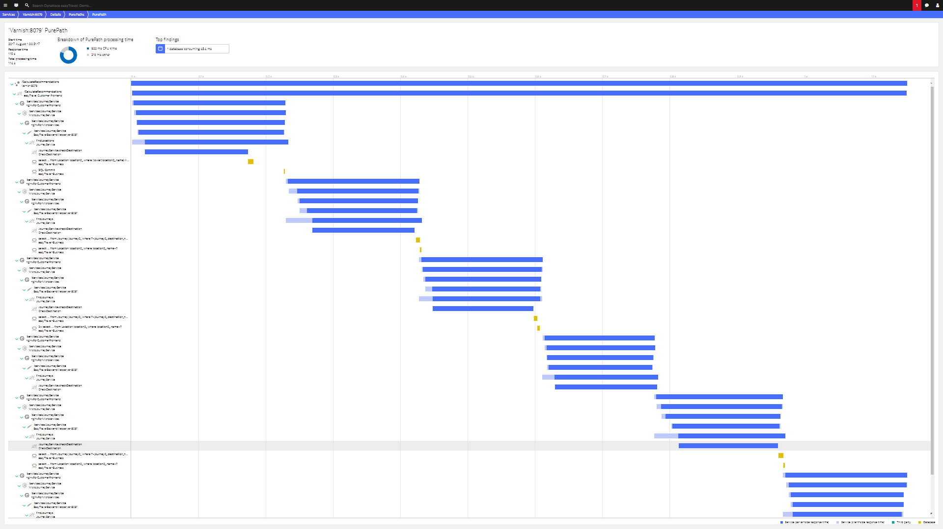
Same N+1 pattern also for svc-2-svc calls
Classical cascading effect of recursive service calls!

Slide 7
More Common Patterns + Metrics to look at
N+1 call: # same Service Invocations per Request
N+1 query: # same SQL Invocations per Request
Payload flood: Transfer Size!
Granularity: # of Service Invocations across End-2-End Transaction
Tight Coupling: Ratio between Service Invocations
Inefficient Service Flow: # of Involved Services, # of Calls to each Service
Timeouts, Retries, Backoff: Pool Utilization, …
Dependencies: # of Incoming & Outcoming Dependencies
More recorded presentations on problem patterns:
Java and Performance: Biggest Mistake - https://www.youtube.com/watch?v=IBkxiWmjM-g (SFO Java Meetup)
Top Performance Challenges: https://www.youtube.com/watch?v=QypHTQr2RXk (Confitura 2019)
Automatically avoid the top performance patterns: https://www.youtube.com/watch?v=lpDMCTgOzV4 (Performance Summit 2021)

Slide 8
Keptn to Automate based on SLOs

Slide 9








Keptn from 10000ft: Declarative, Event Driven
shipyard.yaml
- dev: direct, functional, SLO
- staging: B/G, perf, SLO
- prod: canary, real-user, SLA
remediation.yaml
- high-failure-rate:
- scaleup, rollback
- full-disk:
- cleandir;adjustlog-level
Application Plane (=Process Definition)
Define overall process for delivery and operations
Site Reliability Engineer
Control Plane
Follow application logic and communicate/configure required services
API
Eventing
config.change: artifact:x.y
deploy.finished: http://service1
tests.finished: OK
evaluation.done: 98% Score
problem.open: High Failure
Execution Plane (=Tool Definition)
uniform.yaml
config-change*: helm
deploy*: JMeter
deploy-finish: Lighthouse
problem*: Remediation
all: Slack, Dynatrace
DevOps
Config Service (Git, …)
Deploy Service (Helm, Jenkins …)
Test Service (JMeter, Neotys, ..)
Validation Service (Keptn Lighthouse …)
Monitoring Service
(Prometheus, Dynatrace, …)
Remediation Service
(Keptn Remediation, SNOW …)
Artifact / Microservice
Developer

Slide 10










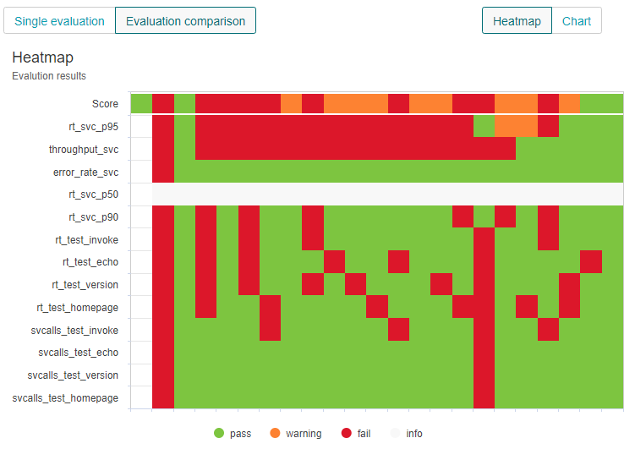
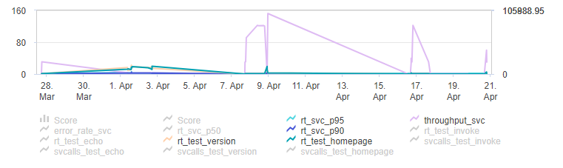
Keptn: Automate pattern analysis through SLOs
CD
~30-60min
~1min
P
E
R
F
O
R
M
A
N
C
E
as
Self-
Svc
Instead of manually test execution and report based analysis
automates test execution and SLO-based evaluation
1
1
2
3
4
x
2
3
4
X
1
2
3
4
x

Slide 11
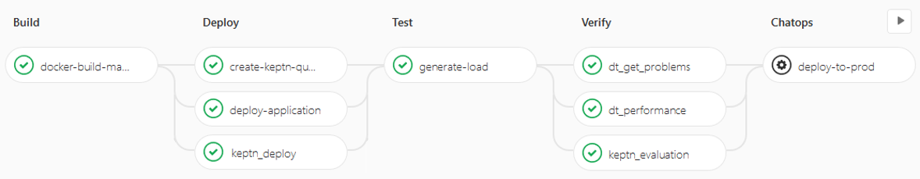


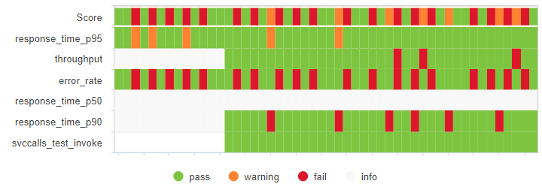


Example: Speeding up GitLab Pipelines by 80%
Trigger Evaluation
87.5%: passed
Automated SLI/SLO based Quality Gates
Christian Heckelmann Senior DevOps Engineer
Pull SLI Metrics

Slide 12

A closer look at SLO Validations
$ keptn send event start-evaluation myproject myservice starttime=build1_deploy endtime=build1_testsdone
$ keptn send event start-evaluation myproject myservice starttime=build2_deploy endtime=build2_testsdone
$ keptn send event start-evaluation myproject myservice starttime=build3_deploy endtime=build3_testsdone
$ keptn send event start-evaluation myproject myservice starttime=build4_teststart endtime=build4_testsend
SLIs (Service Level Indicators)
SLO
pass
Build 1
Build 1
Build 2
Build 3
Build 4
warn
Build 2
Build 3
Build 4
Response Time 95th Perc
Query: builtin:service.responsetime(p95)
<=100ms
80ms
120ms
90ms
95ms
<= 250ms
Overall Failure Rate
Query: builtin:service.errors.total
<= 2%
0%
4%
1%
0%
<= 5%
Test Step LOGIN Response Time
Query: calc:service.teststeprt:filter(Test, LOGIN)
<=150ms & <=+10%
100ms
90ms
120ms
95ms
<= 400ms
Test Step LOGIN # Service Calls
Query: calc:service.testsvc:filter(tx, LOGIN)
<= +0%
1
2
1
1
Open Security Vulnerabilities
Query: calc:secproblems:filter(risk,CRITICAL)
<=0
0
0
1
0
SLO: Overall Score Goal
90%
75%
100%
50%
70.0%
100%

Slide 13
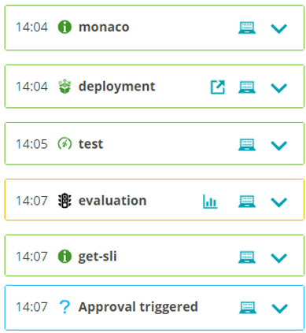

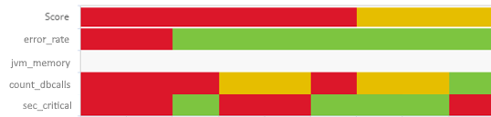




Behind the scenes: How SLO Evaluation works
slo.yaml (SLI Provider independent)
objectives:
- sli: error_rate pass:
- criteria:
- "<=1“ # We expect a max error rate of 1%
- sli: jvm_memory
- sli: count_dbcalls
pass:
- criteria:
- "=+2%" # We allow a 2% increase in DB Calls between builds
warning:
- criteria:
- "<=10" # We expect no more than 10 DB Calls per TX
- sli: sec_critical
pass:
- criteria:
- "<=0" # We do not allow any critical security issues
total_score:
pass: "90%"
warning: "75%"
*evaluation*
Lighthouse Service: Retrieves SLIs and compares them against SLOs
sli.yaml (Prometheus)
indicators:
error_rate: "http_requests_total{status=“error"}"
jvm_memory: "jvm_memory_used_bytes{area="heap"}[1m]"
sec_critical: "rate(falco_events[5m])"
*get-sli*
SLI Providers: Query SLIs based on sli.yaml and return individual values
count_dbcalls: 5
jvm_memory: 360MB
error_rate: 4.3%
sec_critial: 1
sli.yaml (Dynatrace)
indicators:
error_rate: "builtin:service.errors.total.count"
count_dbcalls: "calc:service.toptestdbcalls"
jvm_memory: "builtin:tech.jvm.memory.pool.committed"
sec_critical: "calc:secproblems:filter(risk,CRITICAL)"
...

Slide 14





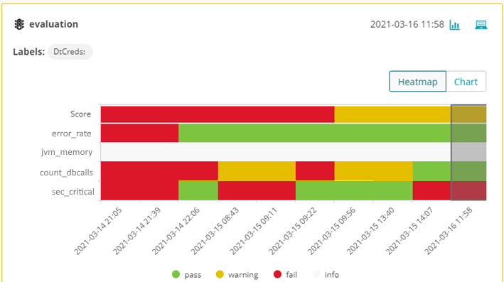










You Pick: SLOs, Testing or E2E-Automation
triggers an automation sequence
orchestrates monitoring config, deployment, test execution, SLO evaluation & remediation

Slide 15
Keptn in the real world!

Slide 16
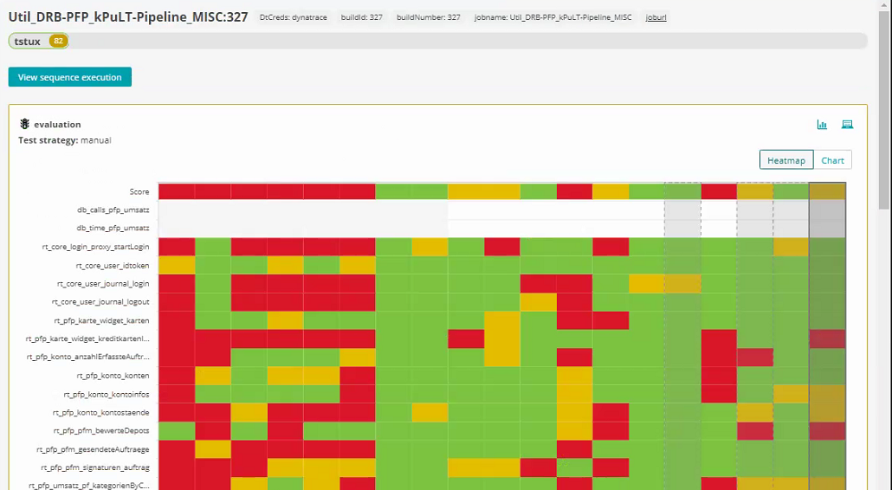
Release Readiness for Austrian Online Banking
#3 Link back to Jenkins
#2 Total SLO Score
per evaluation
#1 List of release relevant SLOs
https://medium.com/keptn/keptn-automates-release-readiness-validation-for-austrian-online-banking-software-eaaab7ad7856

Slide 17
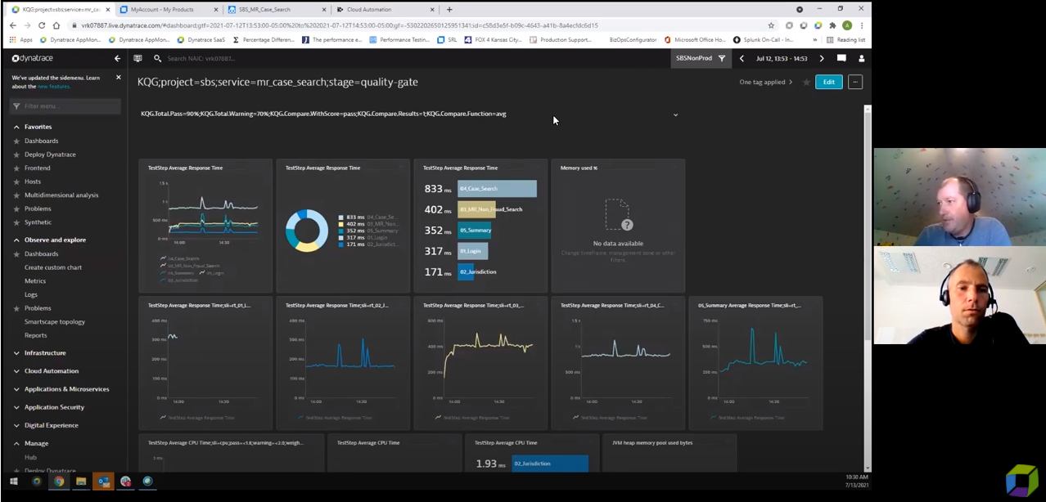
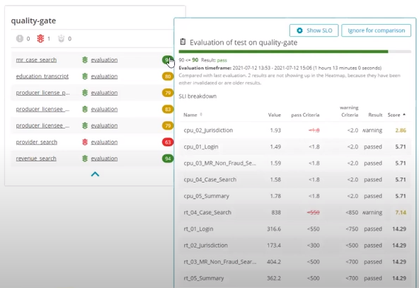
Automated Performance Test Analysis
https://www.youtube.com/watch?v=6vd8rtcoV9k&list=PLqt2rd0eew1YFx9m8dBFSiGYSBcDuWG38&index=5&t=2s

Slide 18
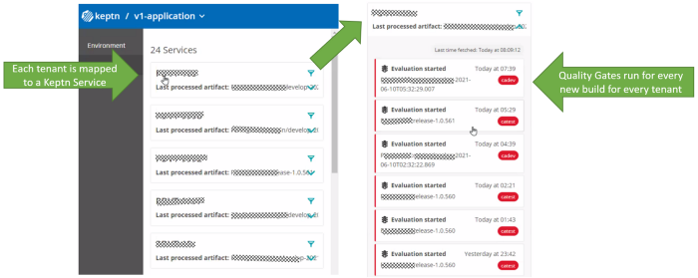
Multi-Tenant Environment Stability Validation
https://medium.com/keptn/validating-environment-stability-with-keptn-c07de8293486

Slide 19
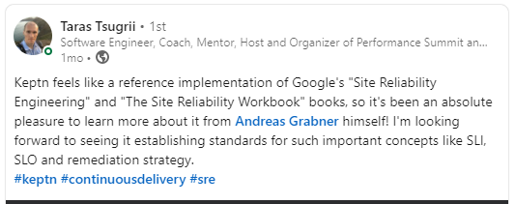
Keptn recognized by performance engineers

Slide 20
Let’s Wrap it up!

Slide 21
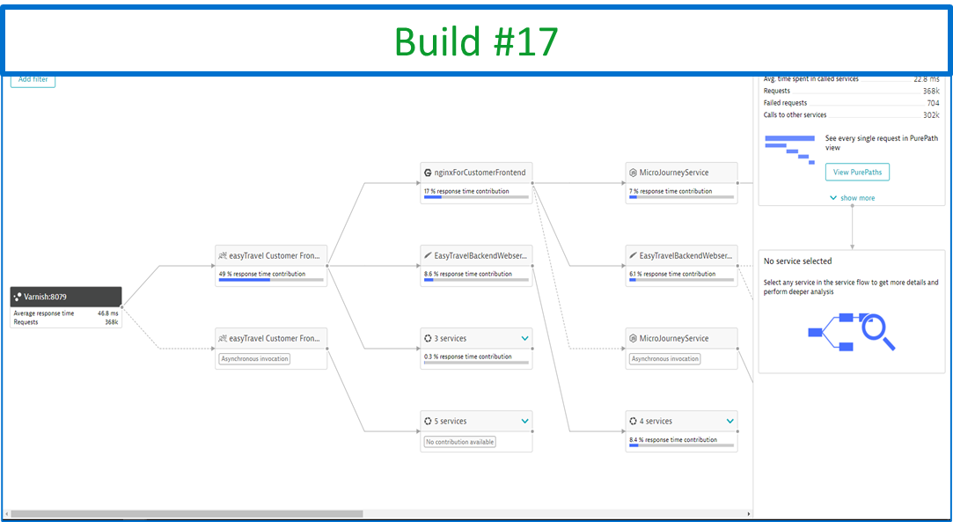
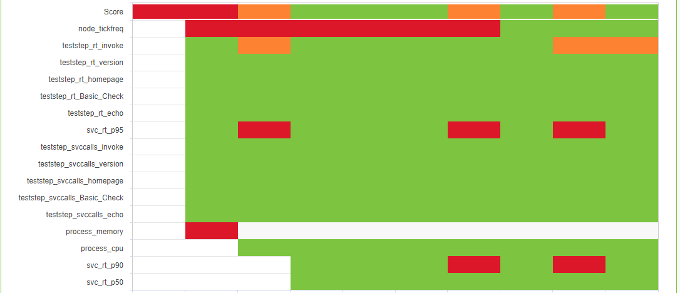
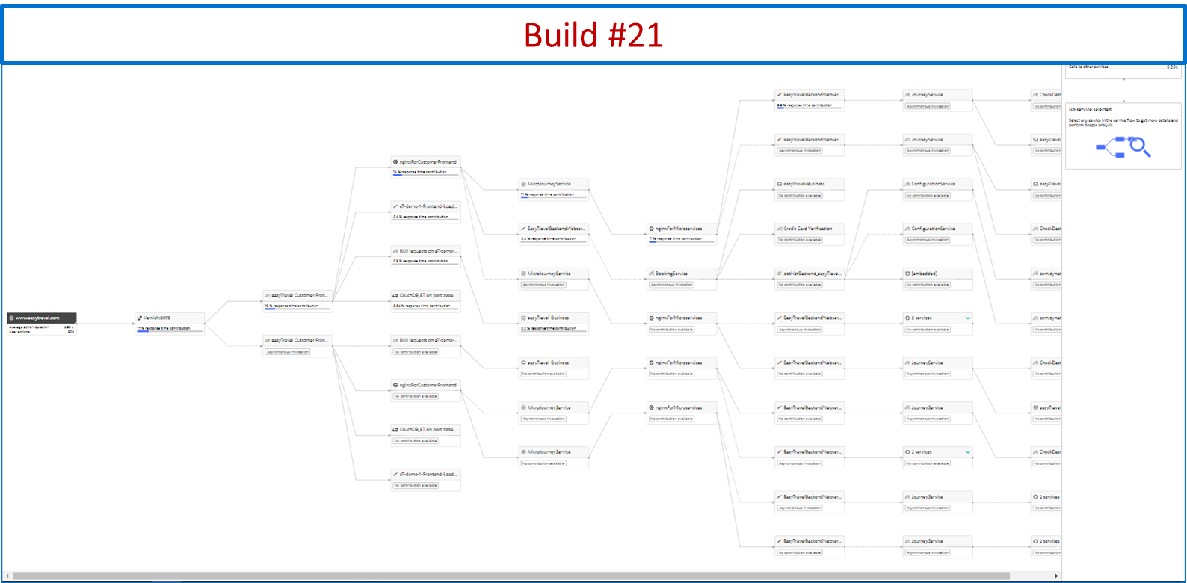







Automate Distributed Problem Detection & Remediation
#1 Understand your Patterns & Define Metrics
#3 Let Keptn automate the analysis
#2 Monitor your metrics (SLIs/SLOs)
#4 Integrate Keptn into Delivery & Operations

Slide 22
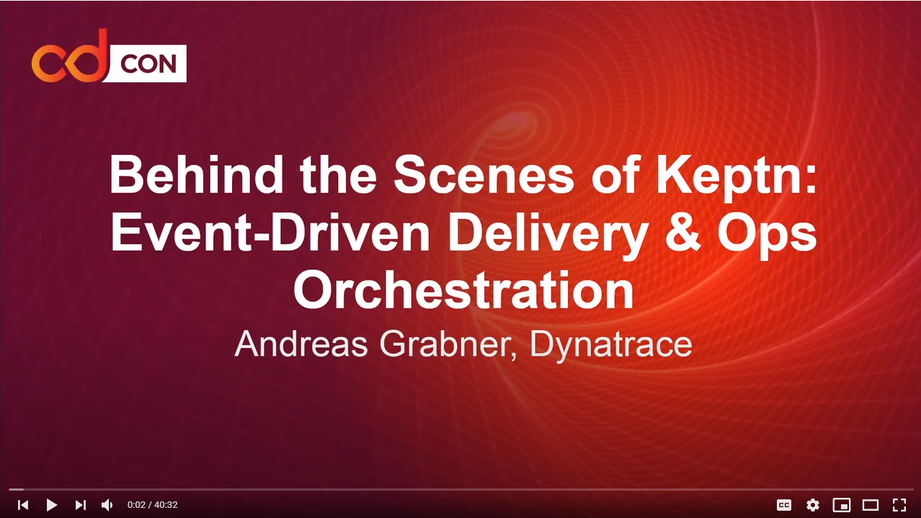
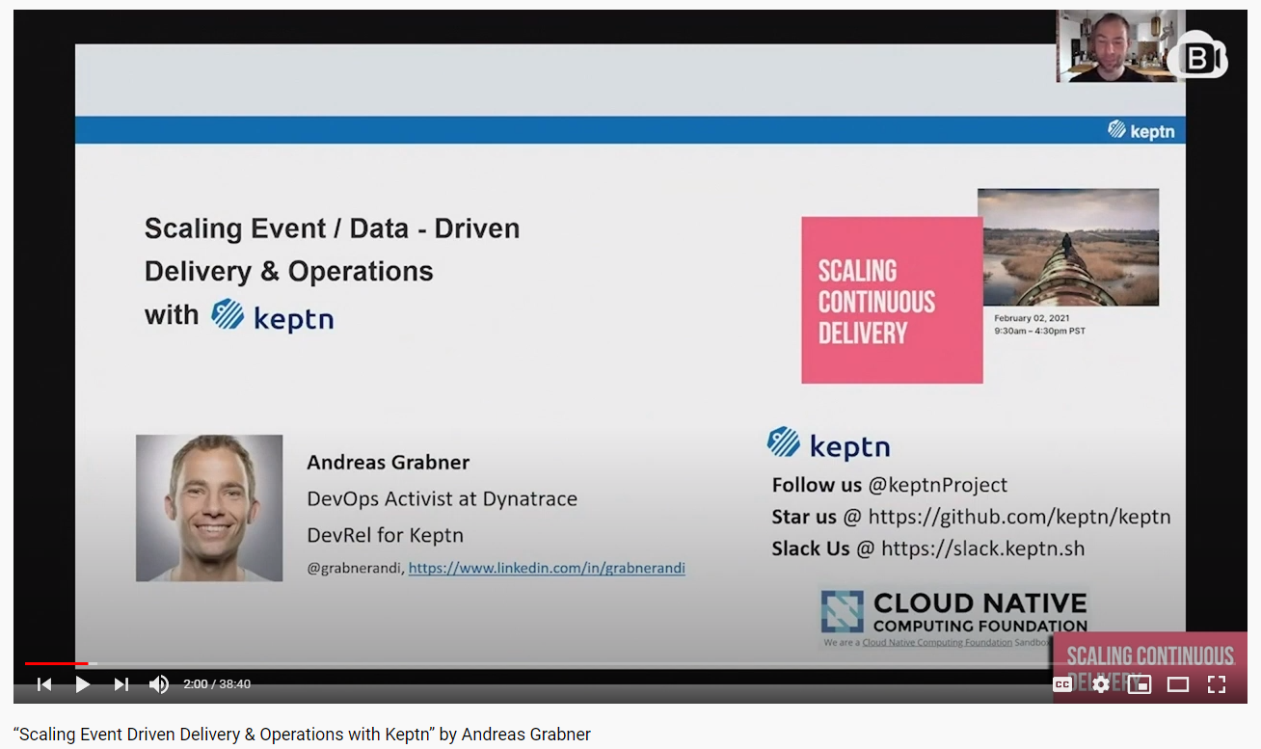
Want to learn more about Keptn?
https://www.youtube.com/watch?v=_j50rleFjHA
https://www.youtube.com/watch?v=wmP9FI6tHtg&list=PL2KXbZ9-EY9TWsV-Jz8ARSt1ko0Yd36ah&index=31

Slide 23
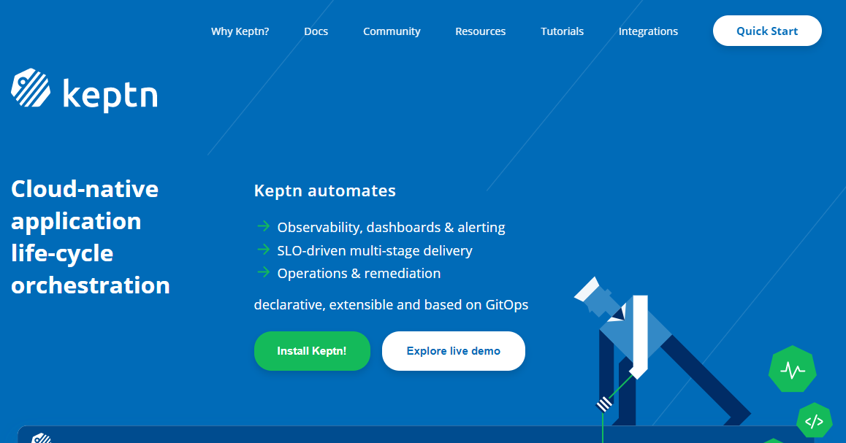
New community members welcome!
Visit us @ https://keptn.sh
Follow us @keptnProject
Star us @ https://github.com/keptn/keptn
Slack Us @ https://slack.keptn.sh

Slide 24
Using SLOs for Continuous Performance Optimizations of your k8s workloads
“Proudly powered by our CNCF project ”
Andreas Grabner
DevOps Activist at Dynatrace
DevRel for Keptn
@grabnerandi, https://www.linkedin.com/in/grabnerandi
Follow us @keptnProject
Star us @ https://github.com/keptn/keptn
Slack Us @ https://slack.keptn.sh
Notes:
Moving to k8s doesn’t prevent anyone from bad architectural decisions leading to performance degradations, scalability issues or violating your SLOs in production. In fact – building smaller services running in pods connected through service meshes are even more vulnerable to bad architectural or implementation choices. To avoid any bad deployments, the CNCF project Keptn provides automated SLO-based Performance Analysis as part of your CD process. Keptn automatically detects architectural and deployment changes that have a negative impact to performance and scalability. It uses SLOs (Service Level Objectives) to ensure your services always meet your objectives. The Keptn team has also put out SLO best practices to identify well known performance patterns that have been identified over the years analyzing hundreds of distributed software architectures deployed on k8s. Join this session and learn what these patterns are and how Keptn helps you prevent them from entering production.

